Slide 1



Widget, Spinner, Adapter
Presented By Putri Hayati, S.ST, M.Kom
March,2021

Slide 2
WIDGET
https://developer.android.com/reference/android/widget/package-summary.html
The widget package contains (mostly visual) UI elements to use on your Application screen. You can also design your own. To create your own widget, extend View or a subclass. To use your widget in layout XML, there are two additional files for you to create. Here is a list of files you'll need to create to implement a custom widget:
Java implementation file –
This is the file that implements the behavior of the widget. If you can instantiate the object from layout XML, you will also have to code a constructor that retrieves all the attribute values from the layout XML file.
XML definition file –
An XML file in res/values/ that defines the XML element used to instantiate your widget, and the attributes that it supports. Other applications will use this element and attributes in their in another in their layout XML.
Layout XML [optional]-
An optional XML file inside res/layout/ that describes the layout of your widget. You could also do this in code in your Java file.
ApiDemos sample application has an example of creating a custom layout XML tag, LabelView. See the following files that demonstrate implementing and using a custom widget:
LabelView.java - The implementation file
res/values/attrs.xml - Definition file
res/layout/custom_view_1.xml - Layout file

Slide 3
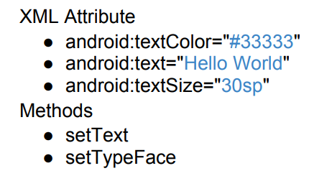
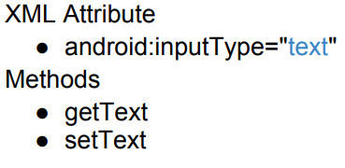
WIDGET
https://developer.android.com/reference/android/widget/package-summary.html
Basic Widgets
TextView
ImageView
Button
EditText
CheckBox
DigitalClock
Widget has properties, you can use activity design to config the properties or use layout editor to edit XML document.
1
2

Slide 4
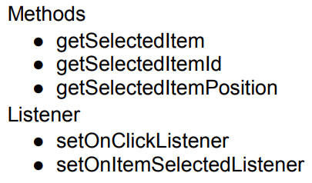
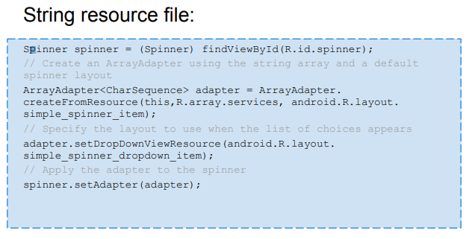
SPINNER
The choices you provide for the spinner can come from any source, but must be provided through an SpinnerAdapter, such as an ArrayAdapter if the choices are available in an array or a CursorAdapter if the choices are available from a database query.

Slide 5
ADAPTER
What is an adapter in android?
An Adapter object acts as a bridge between an AdapterView and the underlying data for that view.
The Adapter provides access to the data items.
The Adapter is also responsible for making a View for each item in the data set.
AdapterView :
The AdapterView is a ViewGroup subclass whose child Views are determined by an Adapter that binds AdapterView object to data of some type.
Typically you are going to use subsclasses of AdapterView class instead of using it directly
Example subclasses of AdapterView class :
ListView
Spinner
Gallery
AdapterView Responsibilities :
Two main responsibilities of AdapterView
Filling the layout with data (it received through the help of an Adapter)
Handling user selections - when a user selects an item, perform some action

Slide 6


OPEN- ANDROID STUDIO

Slide 7
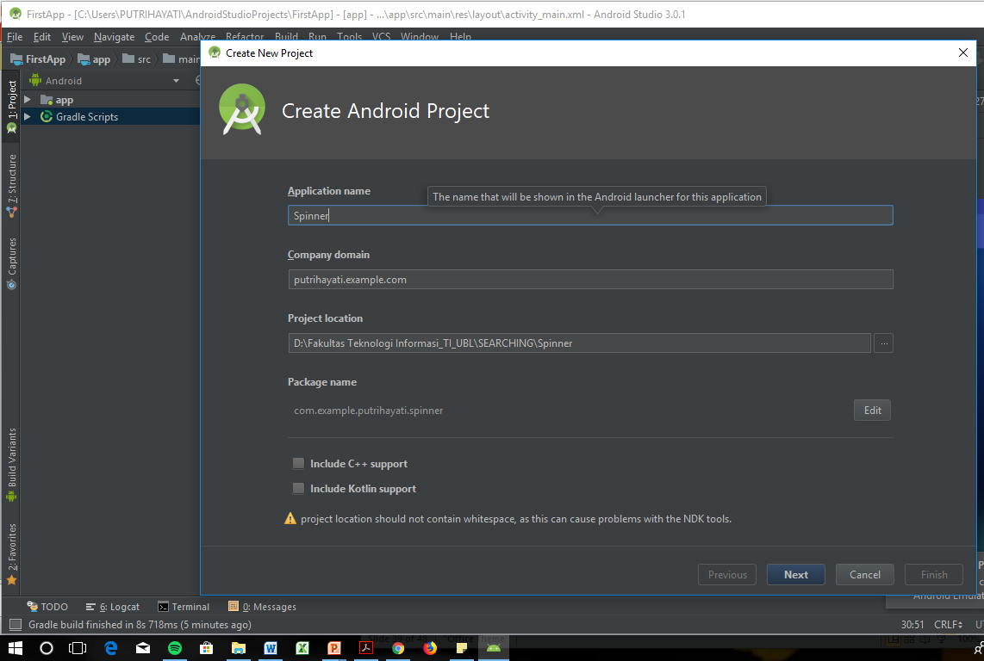
WARNING !!
Application Name: Nim_Spinner_Kelompok

Slide 8
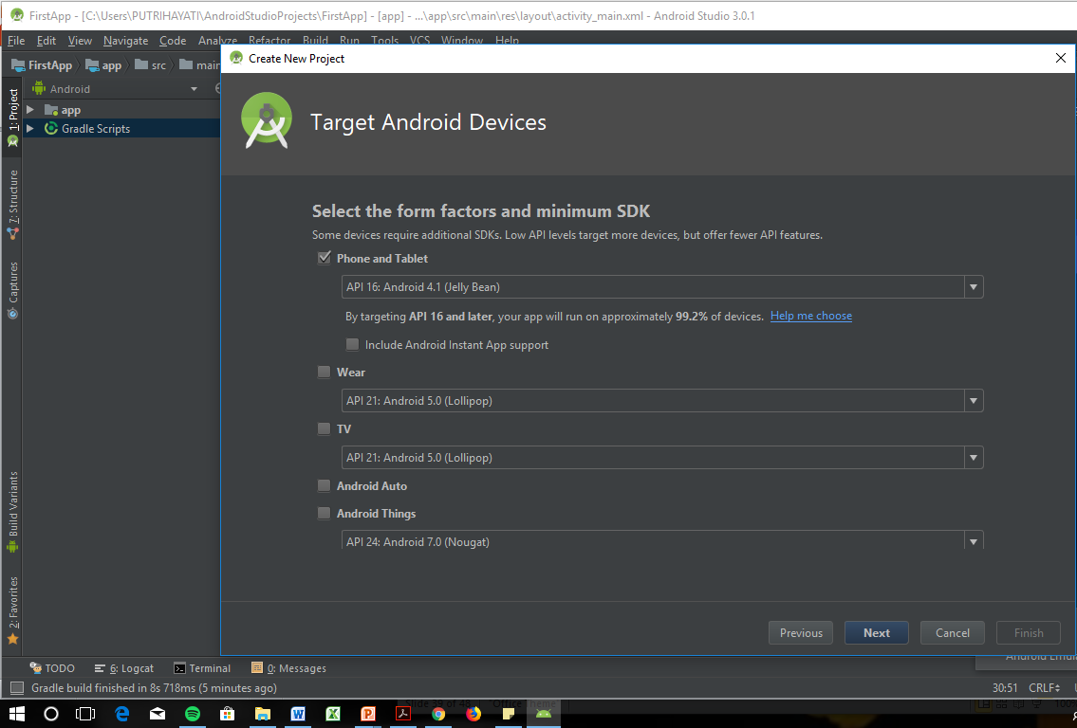

Slide 9
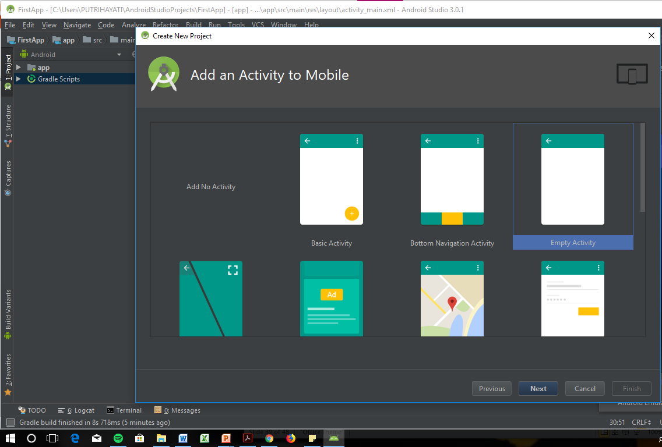

Slide 10
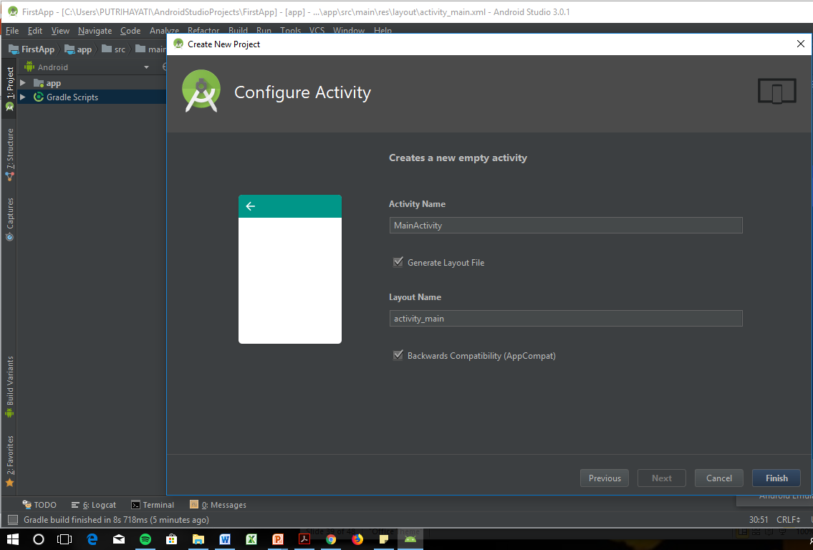

Slide 11
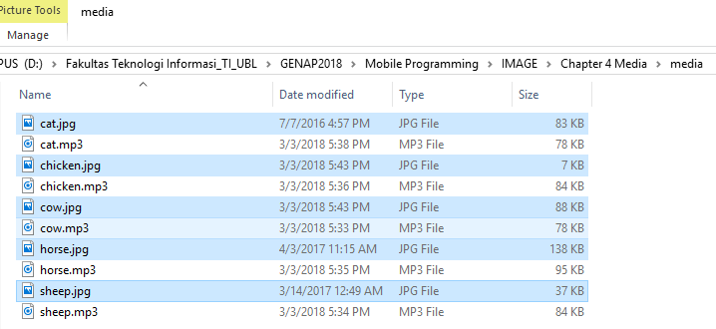
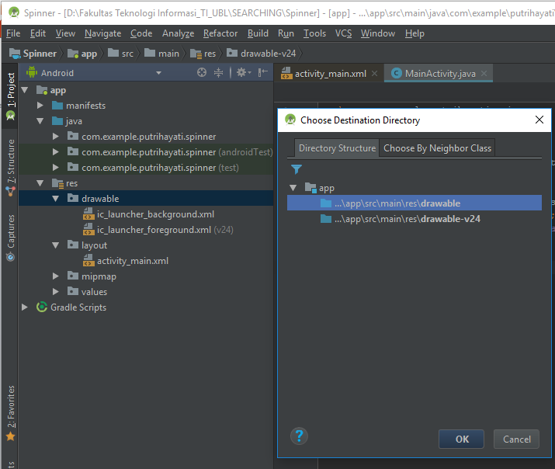
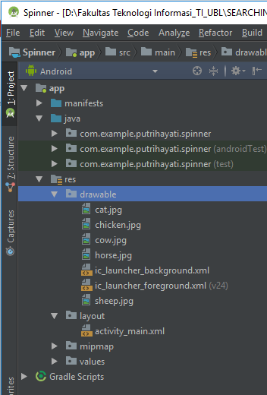
Gambar di samping copypaste ke :
drawable di android studio
1
2
3
4

Slide 12
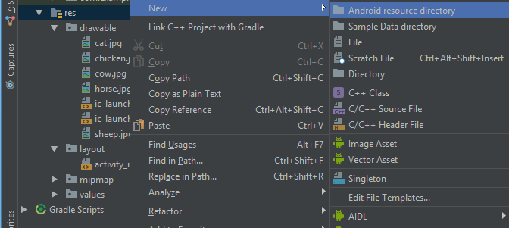
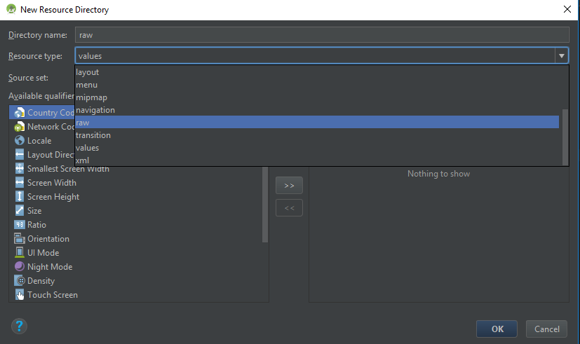
Untuk suara dan video, langkahnya sbb :
1
2

Slide 13
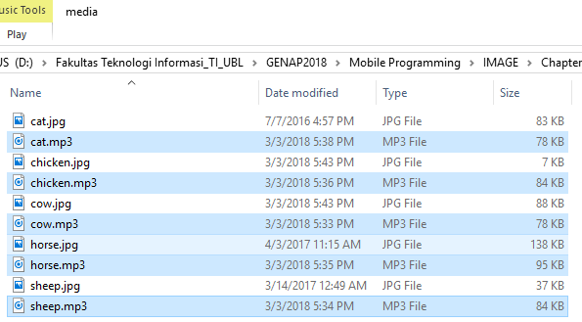
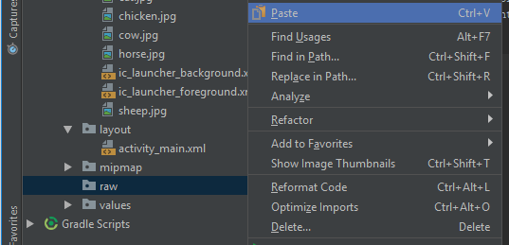
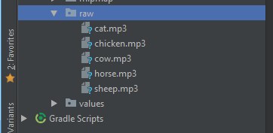
Untuk suara dan video, langkahnya sbb :
1
Audio.mp3 di samping copypaste ke :
RAW di android studio
3
2
4

Slide 14
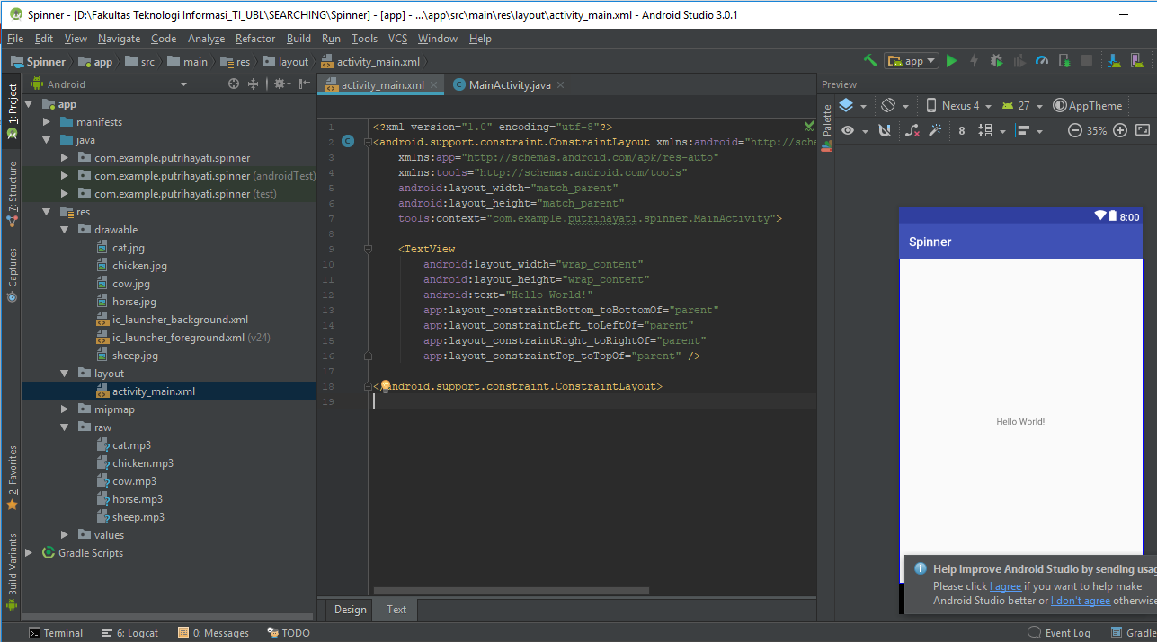
Back to “ Activity_Main”
Before

Slide 15
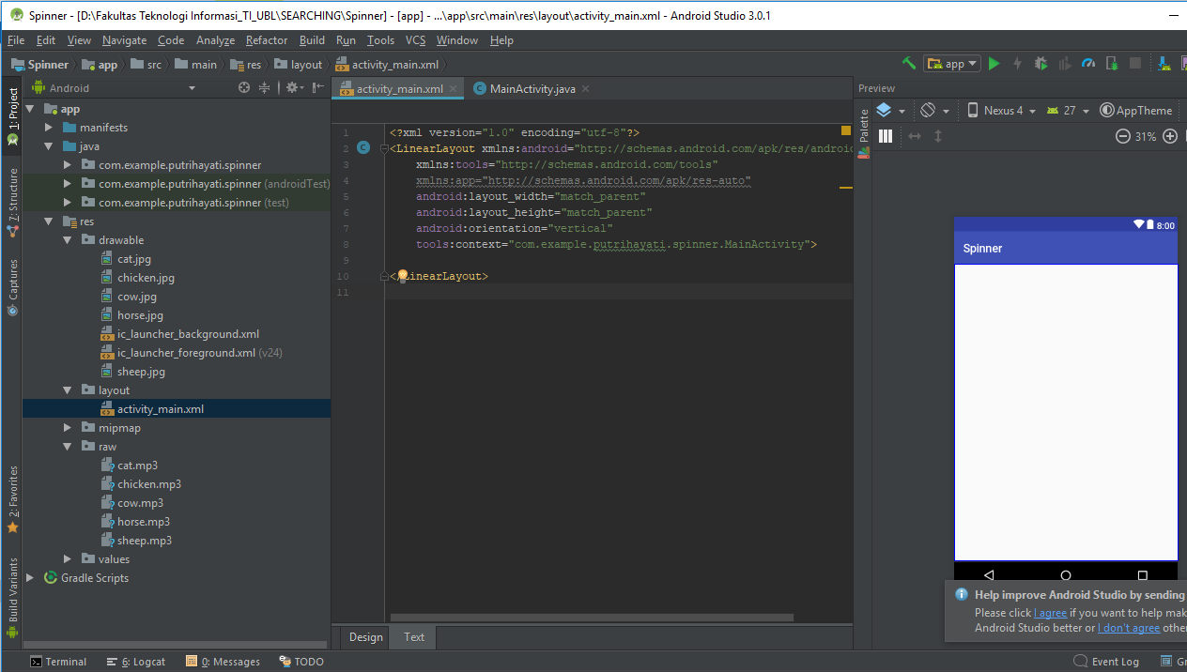
Back to “ Activity_Main”
After

Slide 16
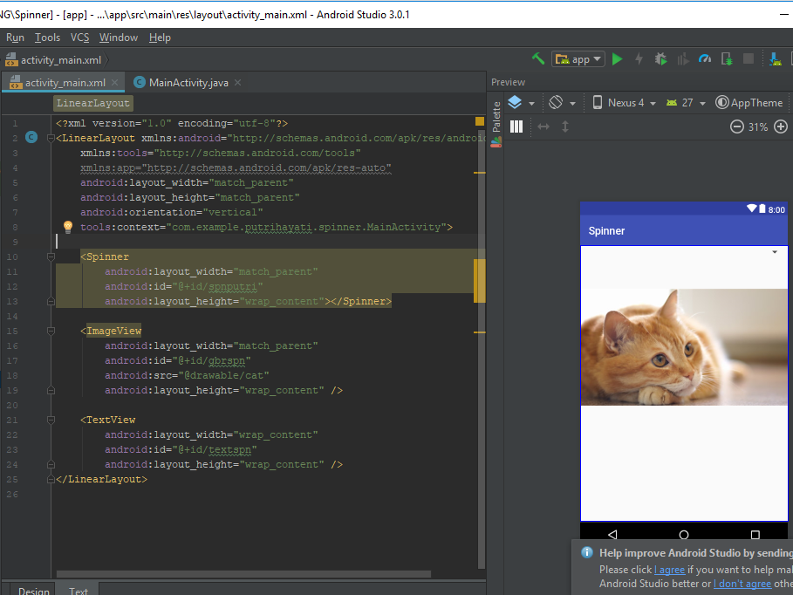
Ketik source code diatas

Slide 17
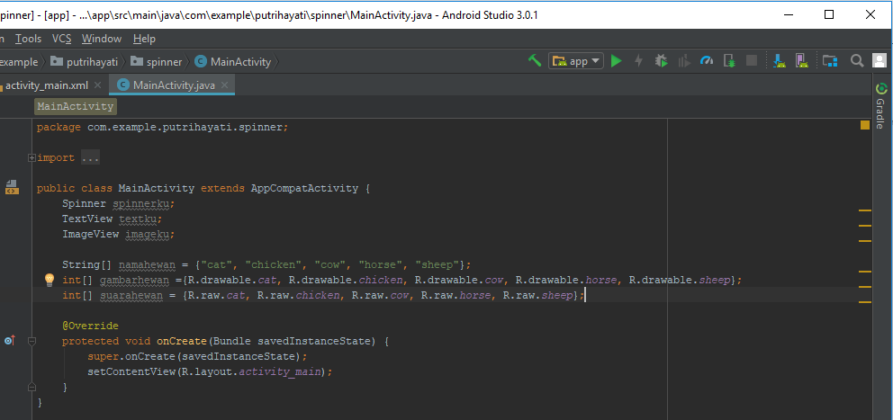
Deklarasi variable di :
Java – MainActivity
1
Deklarasi variable di java, yang akan terkoneksi di ID pada activity_main XML
Array resource untuk memanggil
gambar dan suara.

Slide 18
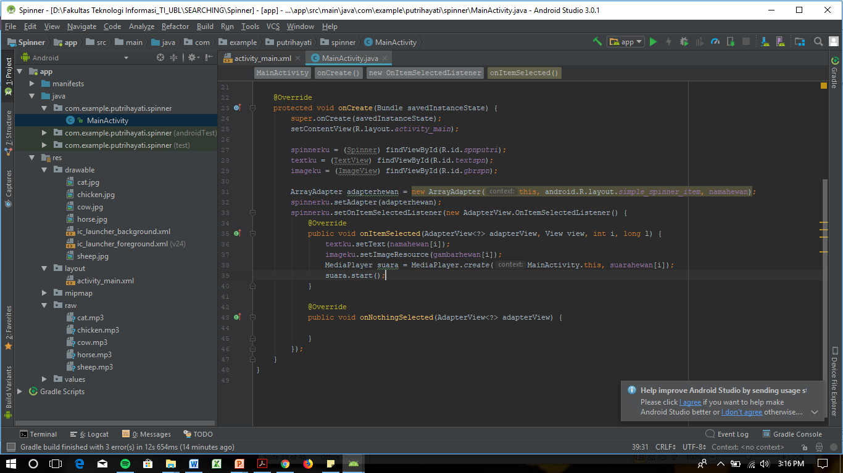
Deklarasi Array di :
Java – MainActivity
2
Setelah di Koneksi
RUN APP

Slide 19

Any Question ???

